Slide 1
Defect Management
Defect , objectives , defect report, defect life cycle

Slide 2
Defect Management
Objectives:
Typical defect reports have the following objectives:
Provide those responsible for handling and resolving reported defects with sufficient information to resolve the issue
Provide a means of tracking the quality of the work product
Provide ideas for improvement of the development and test process

Slide 3
Defect Report Attributes
A defect report logged during dynamic testing typically includes:
Unique identifier
Title with a short summary of the anomaly being reported
Date when the anomaly was observed, issuing organization, and author, including their role
Identification of the test object and test environment
Context of the defect (e.g., test case being run, test activity being performed, SDLC phase, and other relevant information such as the test technique, checklist or test data being used)
Description of the failure to enable reproduction and resolution including the steps that detected the anomaly, and any relevant test logs, database dumps, screenshots, or recordings
Expected results and actual results

Slide 4
Defect Report Attributes
Severity of the defect (degree of impact) on the interests of stakeholders or requirements
Priority to fix
Status of the defect (e.g., open, deferred, duplicate, waiting to be fixed, awaiting confirmation testing, re-opened, closed, rejected)
References (e.g., to the test case)

Slide 5
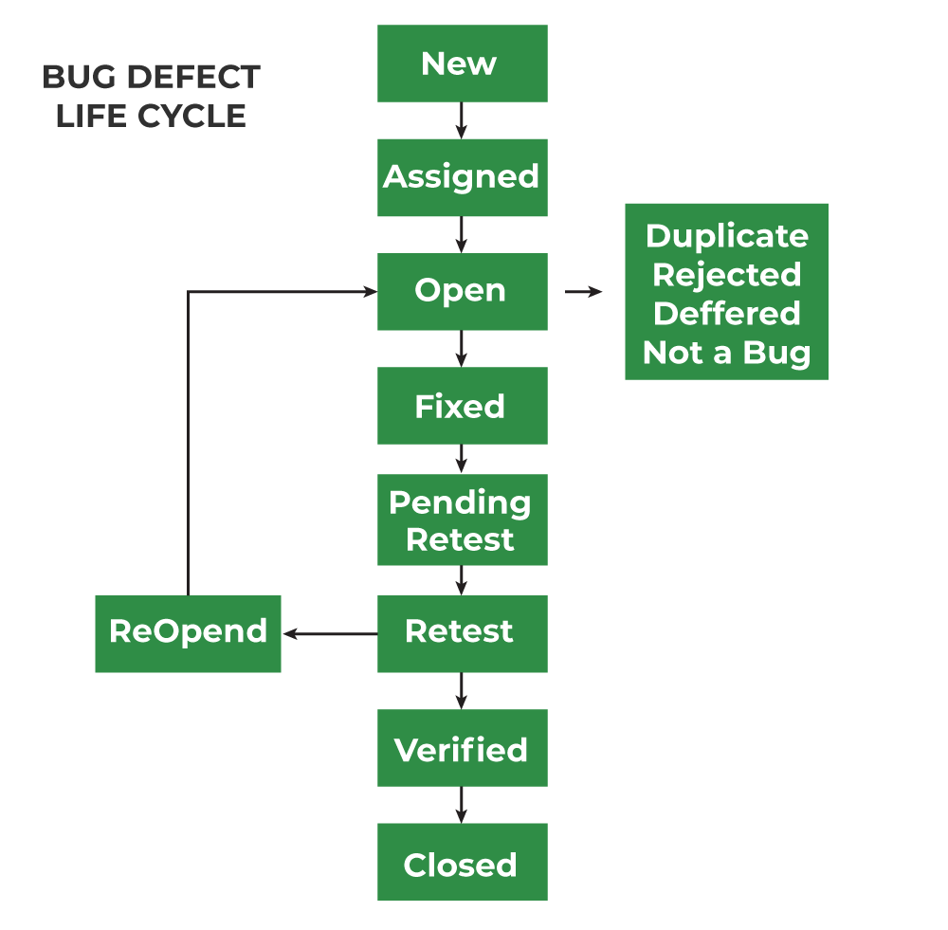
Defect life cycle In the Software Development Process, the Defect Life Cycle is the life cycle of a defect or bug that it goes through covering a specific set of states in its entire life. Mainly bug life cycle refers to its entire state starting from a new defect detected to the closing off of that defect by the tester. Alternatively, it is also called a Bug Life Cycle.

Slide 6
Defect life cycle
The journey of the Defect Cycle varies from organization to organization and also from project to project because development procedures and platforms as well as testing methods and testing tools differ depending upon organizations and projects.
The number of states that a defect goes through also varies depending upon the different tools used and processes followed during the software testing.
The objective of the defect lifecycle is to easily coordinate and communicate the current status of the defect and thus help to make the defect-fixing process efficient.

Slide 7
Defect Status
Defect status or Bug status is the current state from which the defect is currently going through. The number of states the defect goes through varies from project to project. The below diagram illustrates all the possible states of the defect:
1. New: When any new defect is identified by the tester, it falls in the 'New’ state. It is the first state of the Bug Life Cycle. The tester provides a proper Defect document to the Development team so that the development team can refer to Defect Document and can fix the bug accordingly.
2. Assigned: Defects that are in the status of 'New' will be approved and that newly identified defect is assigned to the development team for working on the defect and to resolve that. When the defect is assigned to the developer team the status of the bug changes to the 'Assigned' state.
3. Open: In this 'Open' state the defect is being addressed by the developer team and the developer team works on the defect for fixing the bug. Based on some specific reason if the developer team feels that the defect is not appropriate then it is transferred to either the 'Rejected' or 'Deferred' state.
4. Fixed: After necessary changes of codes or after fixing identified bug developer team marks the state as 'Fixed'.

Slide 8
Defect Status
5. Pending Retest: During the fixing of the defect is completed, the developer team passes the new code to the testing team for retesting. And the code/application is pending for retesting on the Tester side so the status is assigned as 'Pending Retest'.
6. Retest: At this stage, the tester starts work of retesting the defect to check whether the defect is fixed by the developer or not, and the status is marked as 'Retesting'.
7. Reopen: After 'Retesting' if the tester team found that the bug continues like previously even after the developer team has fixed the bug, then the status of the bug is again changed to 'Reopened'. Once again bug goes to the 'Open' state and goes through the life cycle again. This means it goes for Re-fixing by the developer team.
8. Verified: The tester re-tests the bug after it got fixed by the developer team and if the tester does not find any kind of defect/bug then the bug is fixed and the status assigned is 'Verified'.
9. Closed: It is the final state of the Defect Cycle, after fixing the defect by the developer team when testing found that the bug has been resolved and it does not persist then they mark the defect as a 'Closed' state.

